Slide 1
BUG TREND ANALYSIS
USING ATLASSIAN MCP
Jira Defect Data • Trend Analysis • Root Cause Categorization
L1 Certification Assignment • July 17, 2026

Slide 2
OVERVIEW
Agenda
1
MCP Architecture & Setup
2
Bug Data Collection (Jira)
3
Bug Frequency Trend
4
Severity & Component Analysis
5
Resolution Time Analysis
6
Root Cause Analysis
7
Recommendations & Conclusion

Slide 3
HOW THIS ANALYSIS WAS BUILT
MCP Architecture
Claude
(MCP Client)
Atlassian Remote
MCP Server
Jira Issue
Repository
Bug Trend
Analysis
Claude authenticates via OAuth through Anthropic's Atlassian Remote MCP server — no credentials are handled directly by Claude. All reads/writes to Jira happen as authorized MCP tool calls.

Slide 4
STEP 2–3: JIRA RETRIEVAL
Bug Data Collection
20
6
4
SCRUM-5–24
Bug Records
Modules Covered
Discovery Phases
Issue Range
Tools used: getAccessibleAtlassianResources → searchJiraIssuesUsingJql → createJiraIssue (fill gaps) → getJiraIssue (verification)
Modules: Authentication • Payment • Backend API • Database • Frontend • Notifications
Each record includes: Issue Key, Type, Summary, Description, Priority, Status, Created/Resolved Date, Component, Reporter, Assignee, Testing Phase Found, Root Cause Category.

Slide 5
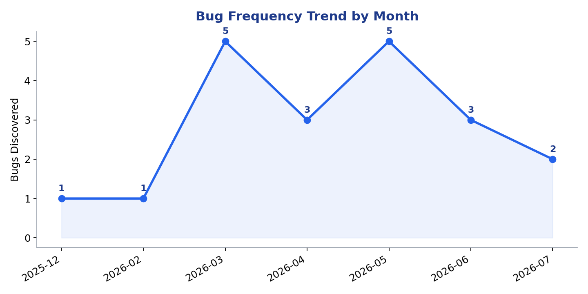
STEP 4.1
Bug Frequency Trend

Slide 6
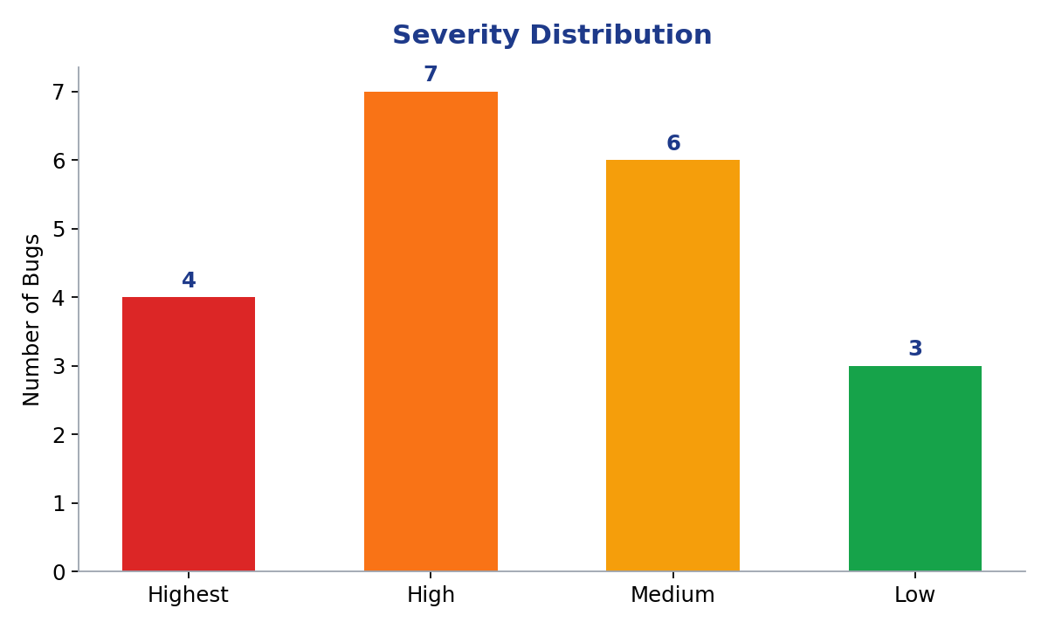
STEP 4.2
Severity Analysis
Highest
4
High
7
Medium
6
Low
3
55% of bugs are High or Highest severity — concentrated in Payment & Backend API.

Slide 7
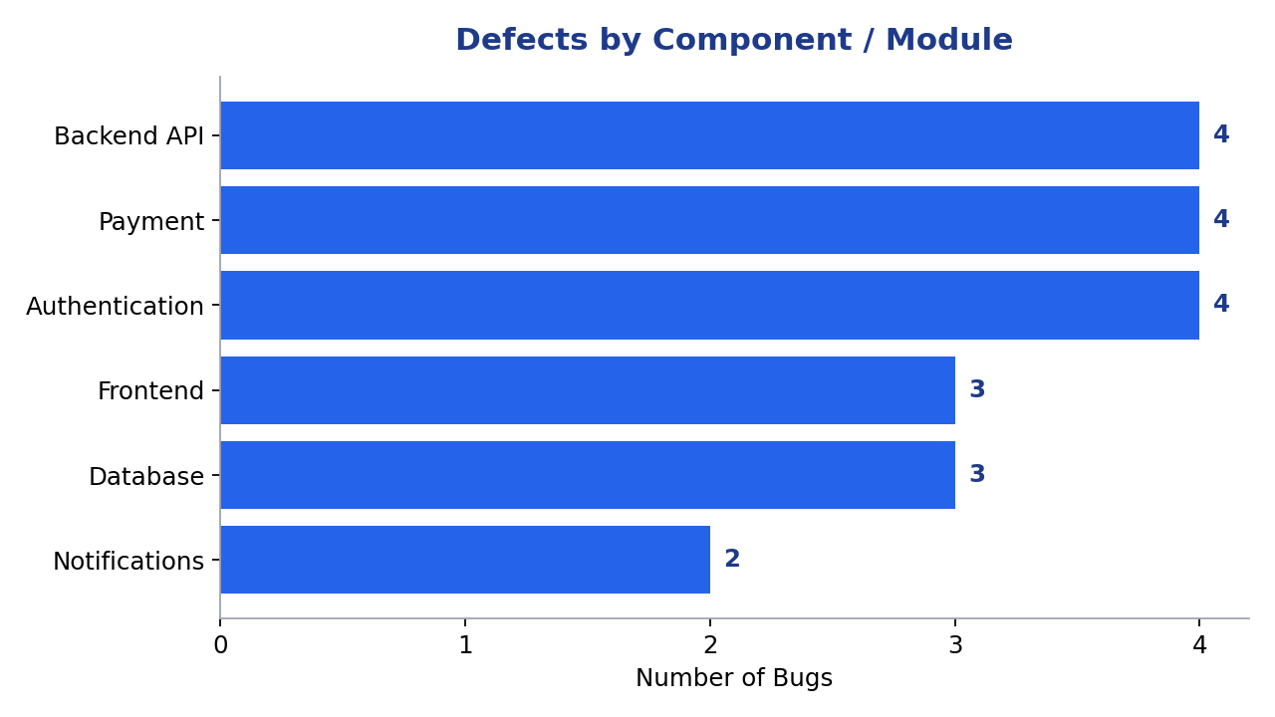
STEP 4.3
Component Analysis

Slide 8
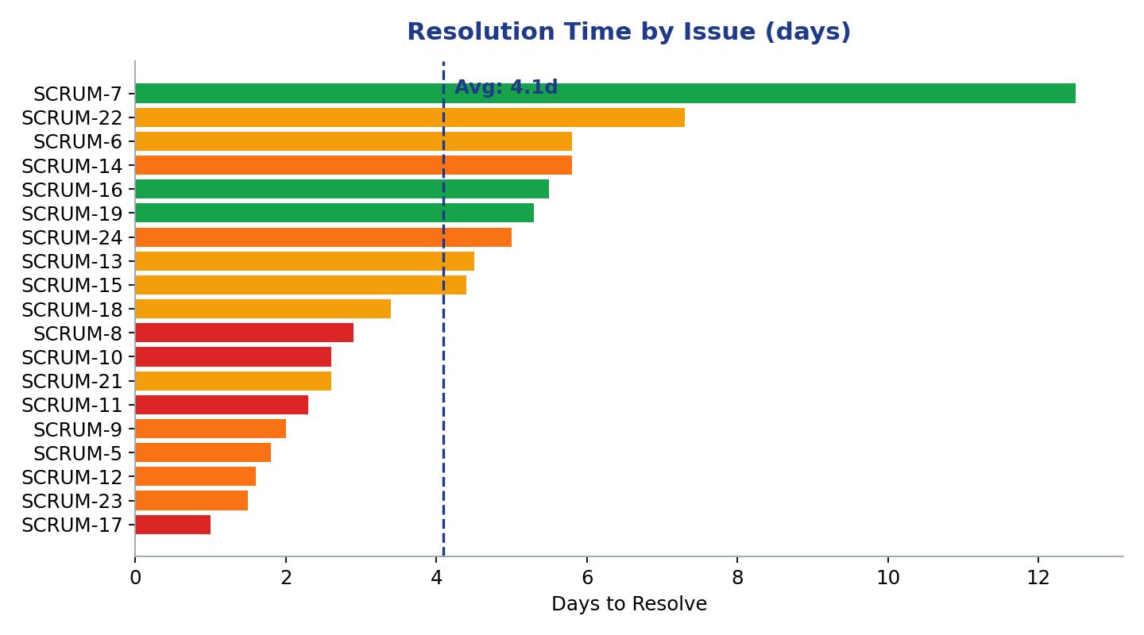
STEP 4.4
Resolution Time Analysis
4.09 days
1.0 day
12.5 days
Average
Minimum (SCRUM-17)
Maximum (SCRUM-7)

Slide 9
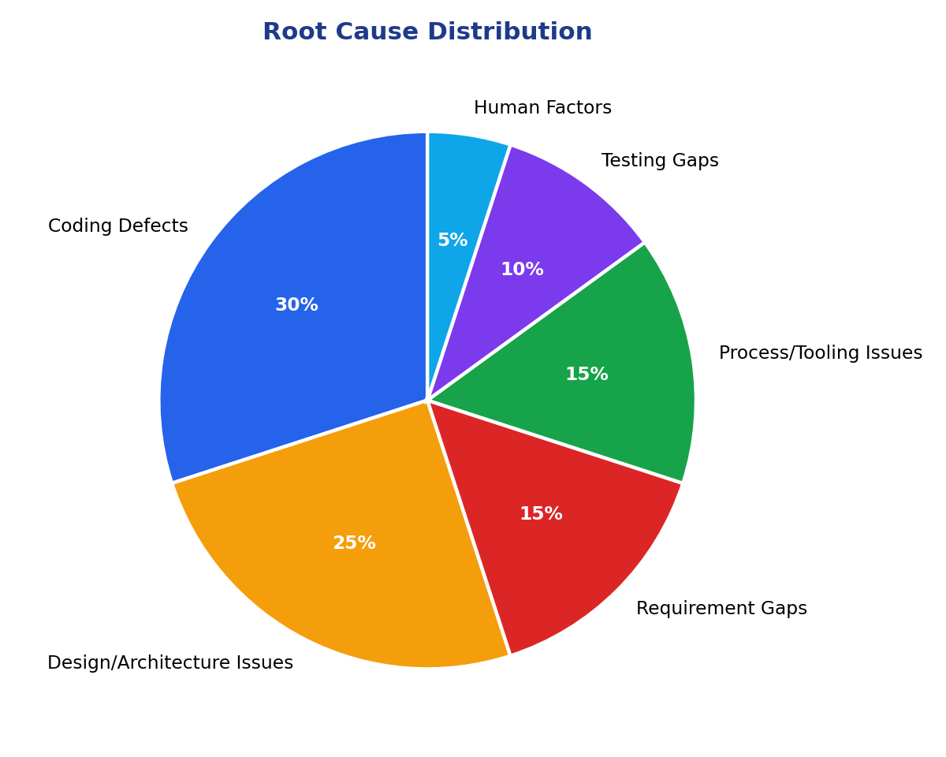
STEP 5
Root Cause Analysis
Coding Defects
30%
Design/Architecture Issues
25%
Requirement Gaps
15%
Process/Tooling Issues
15%
Testing Gaps
10%
Human Factors
5%
Coding Defects + Design/Architecture Issues = 55% of all bugs.

Slide 10
STEPS 9–10
Recommendations & Conclusion
Better requirement gathering — spell out edge cases in acceptance criteria
Expanded regression testing — re-test SSO & data-consistency paths
More test automation — idempotency, retry & timezone edge cases
CI/CD quality checks — automated index & slow-query detection
Stronger code review — mandatory 2nd reviewer on payments/auth/webhooks
Better cross-team communication — design checkpoint before build
Coding Defects and Design/Architecture Issues drive over half of all defects — closing that gap through stronger review and edge-case testing is the highest-leverage next step.

